Slide 1
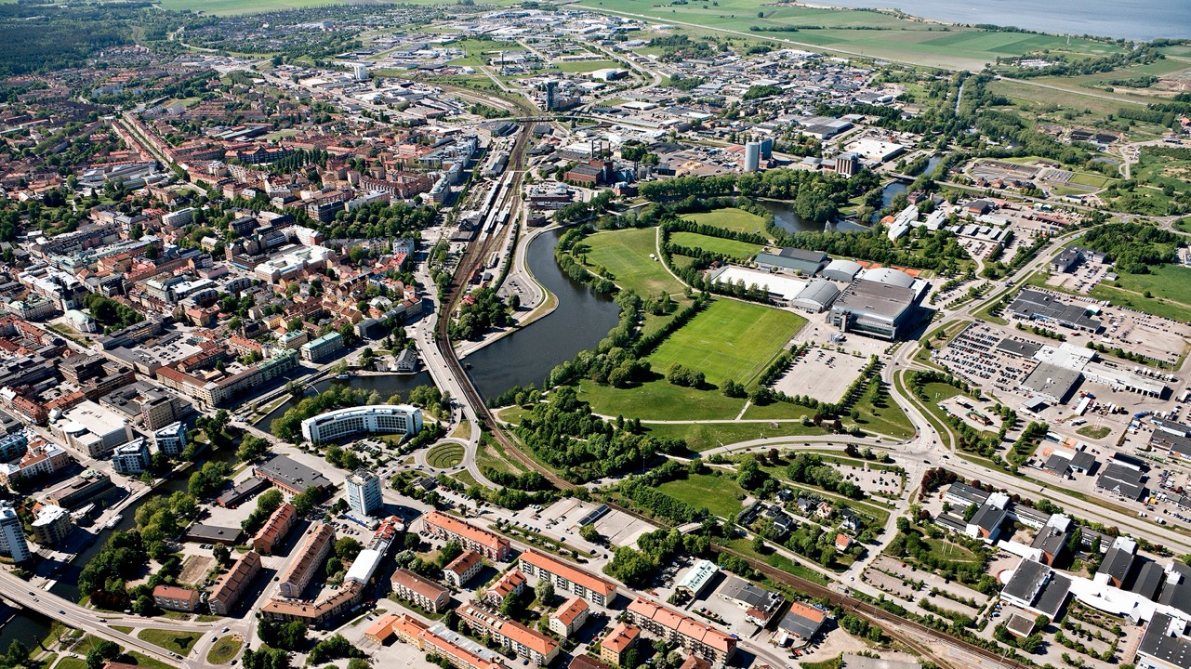
Brand platform
Linköping
Future Now

Slide 2
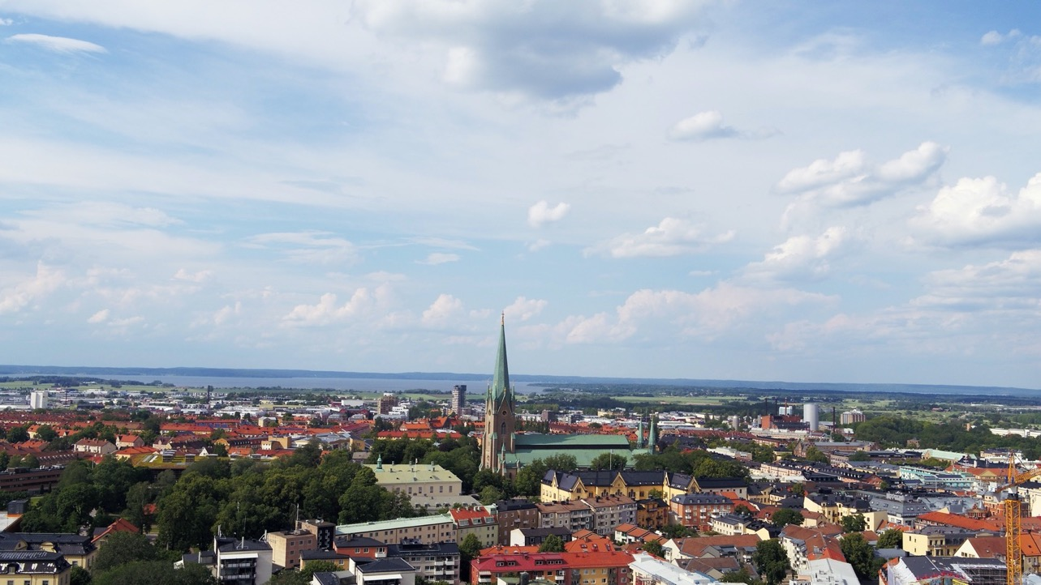
The brand platform is our mutual guiding star
It highlights Linköping's main strengths and advantages and sums up what we want the outside world to associate with Linköping.
With a common basis to start from, we can communicate uniformly and clearly, which is the basis for efficient communication.
As a result, we create a more attractive place for all of us who already live and are active here, more become ambassadors for their city, but also:
More people want to visit us
More people want to start a business here
More people want to work here
More people want to move here for good
Notes:
Why has Linköping Municipality developed a brand platform?
Unfortunately, many places are similar. We want more people to move here, work, study or start a business here and we need the workforce.
Both public and private entities need to hire more people.
So it’s a good time to think about what it is that distinguishes us from other competing cities or places. It should be by far the most important strengths and benefits that we want the outside world to associate with Linköping.
Once you've come up with some answers, write them down in a platform, as we call it. Then it becomes a tool in everyday life and the brand platform becomes a guiding star for communication.

Slide 3
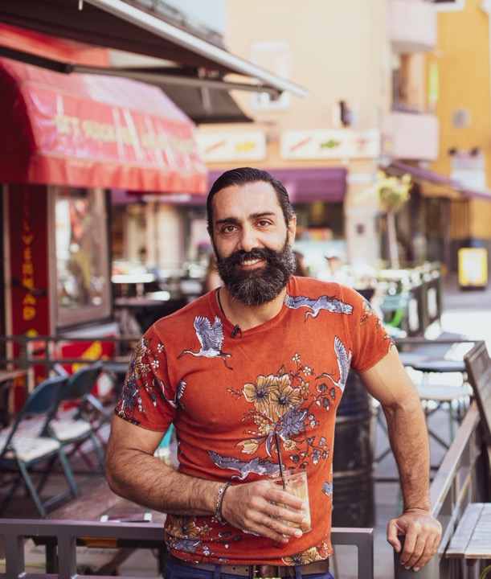
We develop Linköping as an attractive place together

Slide 4
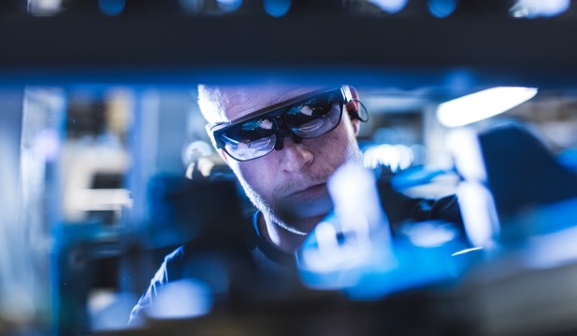
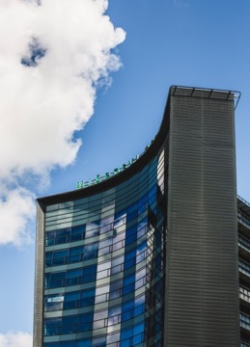
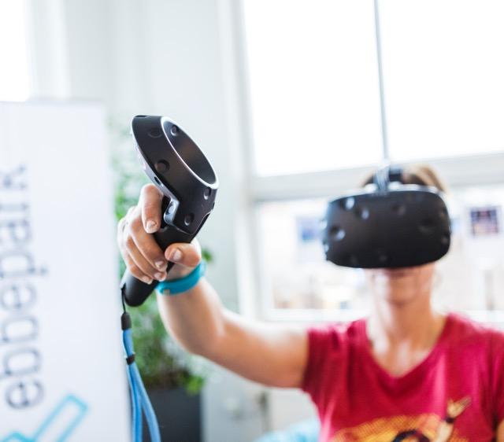

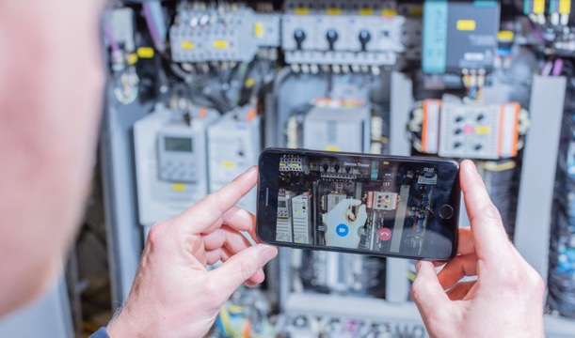
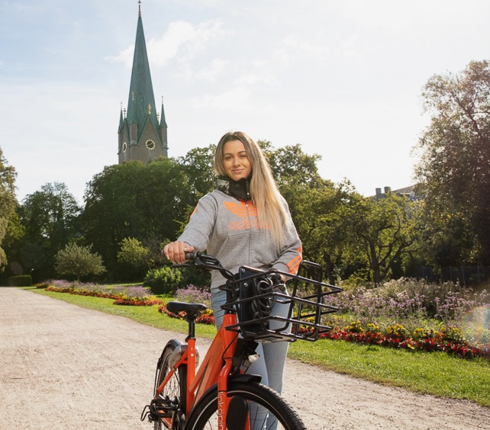
01
The groundbreaking innovations
Notes:
The basis for differentiating Linköping from other cities is high-tech. It is the essence of this place:
GSM was the basis for mobile communication, and important parts were developed by Ericsson in Linköping. Now, Ericsson is at the forefront of 5G research and development
Digital image analysis with the development of the Digital Autopsy Table at CMIV (Centre for Medical Imaging and Visualisation) at Linköping University Hospital.
Streaming media, the foundation of Netflix, HBO etc
The approved crypto phone (SECTRA)
The innovations will continue …

Slide 5
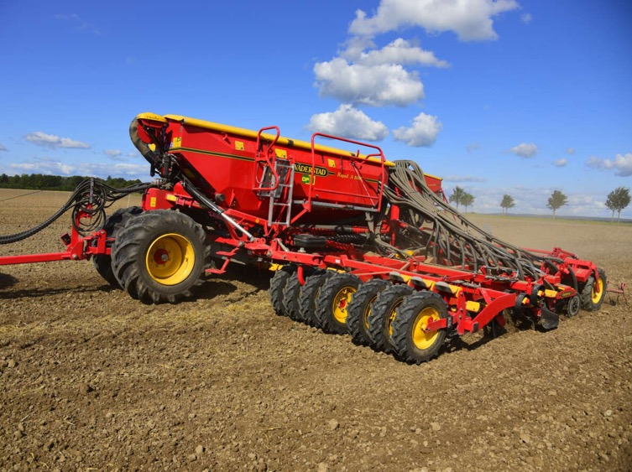
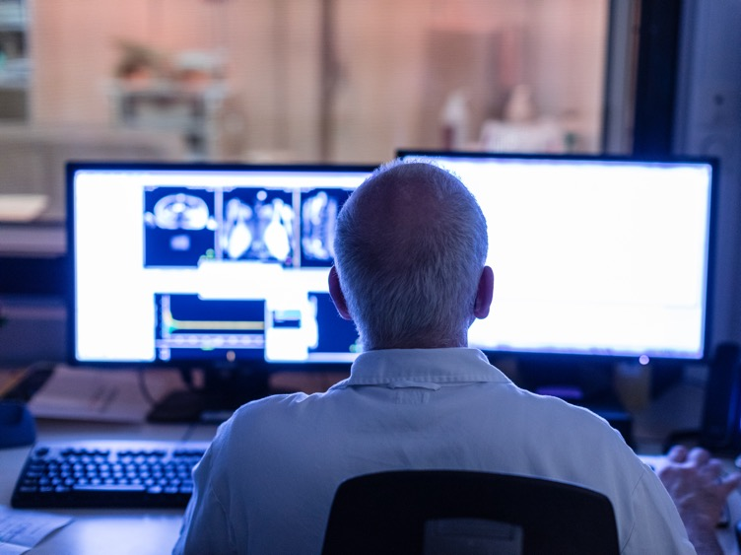
Technologies and innovations for the future
Linköping has high technology and innovation in its DNA.
A strong and broad business community, which leads to interesting career opportunities
Carbon neutrality 2025
Linköping University with world-class education and research
Agtech 2030
WASP
Linköping University Hospital is a leader in several care disciplines and is ranked among the best in the country
Foto: Pressbild Väderstad
Notes:
Because we are leaders in several high technology areas. They are characterised by a rapid pace of innovation:
Aeronautics
Vehicle safety
Internet of things
IT and mobile communication
Technology for a sustainable environment
Around the core of technology, the business community is developed and diversified (a diversity equivalent to a big city)
and mainly in growing industries.
provides opportunities for career variation and opportunities
The most ambitious goal in Sweden where we in the municipality work hard to achieve carbon neutrality in 2025. Tekniska Verken play an important role in this work.
Linköping University has world-class education and research. The University is also a driving force for new ideas as the basis for new companies. There are also, many interesting research areas, such as:
Agtech 2030 innovation environment for tomorrow's agriculture, where sensors, digital technology, AI and the Internet of Things will be used. Linköping has high competence in this area.
WASP – largest research initiative in Sweden. It is an investment in basic research, education and recruitment in autonomous systems and software development located at Chalmers, KTH, Umeå, Lund and Linköping University, with Linköping University as the host. WASP is the largest single research initiative in Sweden
Linköping University Hospital (US) is one of the best university hospitals in Sweden (has been named the best 3 times in the last 5 years). Several clinics have results in the international top class. Is the national unit for advanced burns, patients in need of gender reassignment are treated from all over the Nordic region.

Slide 6
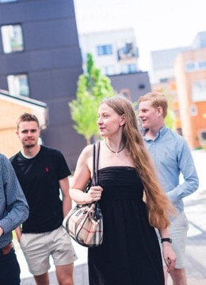
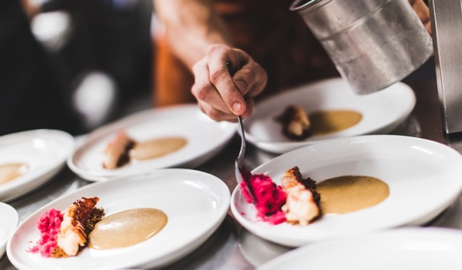

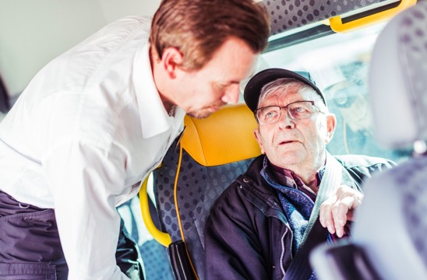
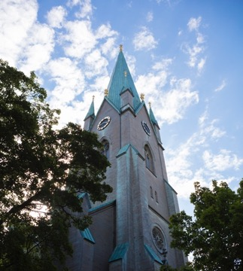
02
The life-friendly city

Slide 7
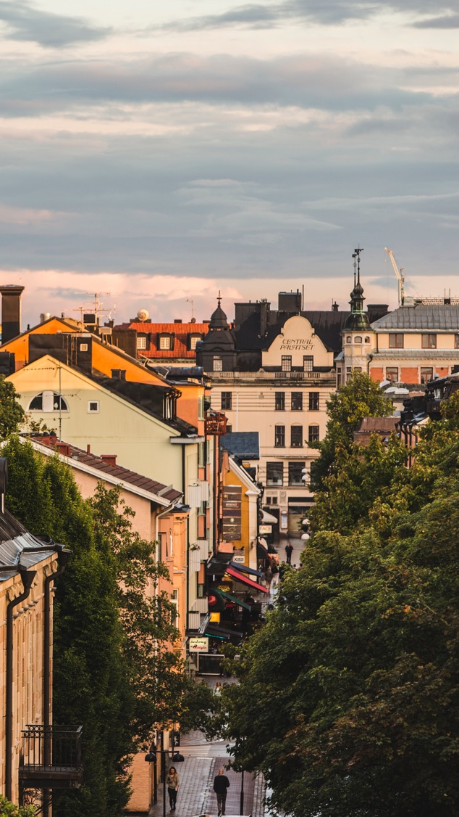

Foto: Kenny Bengtsson/Folio, Gettyimages
A life-friendly, sustainable and growing city
A welcoming place
Linköping is growing with new residents, companies and exciting neighbourhoods
The city centre has been named the city centre of the year three times
Rich selection of restaurants, cafés, shopping
Investing in developing a socially and ecologically sustainable city with investments in green travel plans and expanded public transport
Good schools, health care and social care
Easier for families with children to manage the puzzle of everyday life
Notes:
Is pleasant, welcoming (according to Sifo 2019) and has been named Sweden's smartest city (Samhällsbarometern 2019 made by consulting firm PE Teknik & Arkitektur)
Our constant growth is proof that many people like it here. Linköping is a place where you can shape and realise your future according to your ideas. New neighbourhoods such as Vallastaden, Ebbe Park, Folkungavallen etc. are built in Linköping.
The city centre has been named the city centre of the year three times. The prize is awarded by Svenska stadskärnor and is given to the city that shows the greatest progress, development and renewal of the city centre. It is based on cooperation between both private and public entities.
Has a rich selection of restaurants, cafés and shopping. Richly varied range of leisure activities with everything that allows you to live your life and build your future here
Investing in green travel plans and public transport to develop a socially and ecologically sustainable city. Linköping Municipality has a goal of carbon neutrality by 2025. Grön resplan (green itinerary) is an action plan to increase the share of sustainable commuting trips to workplaces, with the aim of reducing carbondioxide emissions.
Has good schools, health care and social care. One example is that Linköping is characterised by a large teacher density and high proportion of trained teachers, making the municipality a highly ranked school municipality (Lärarförbundet (teacher’s union) 2019). Good care is available nearby through the university hospital, which has been named the best in Sweden three times.
It’s big enough, but not too big, to be able to combine a very interesting labour market with managing the daily puzzle of a family with children

Slide 8
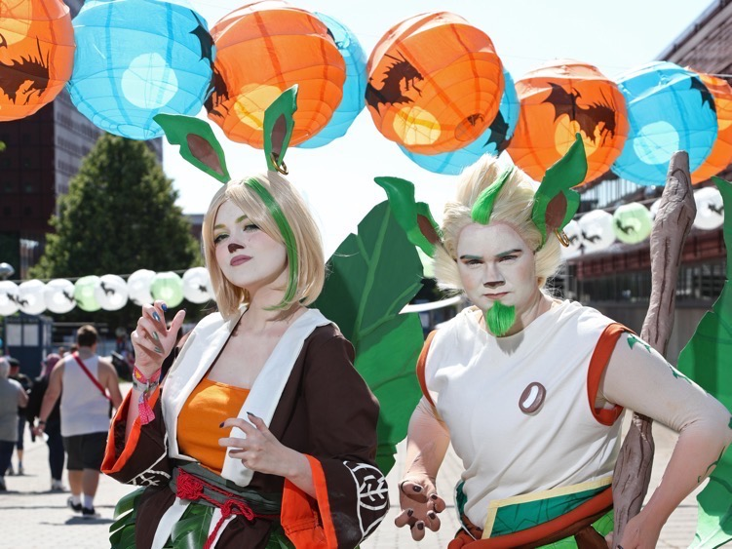
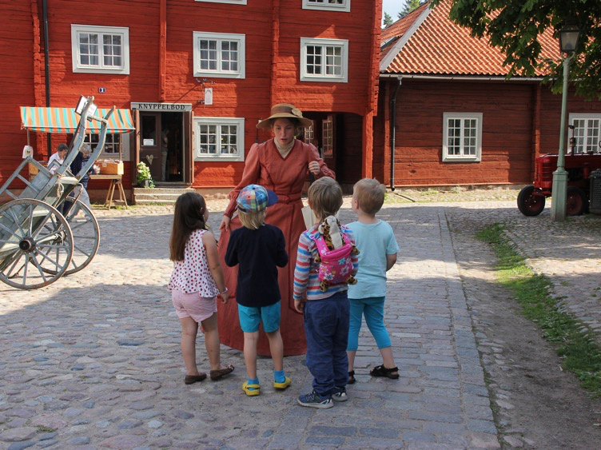
Creativity and exciting meeting places
Cultural and event routes from Gamla Linköping (Old Linköping) through the inner city's Concert and Congress Hall to Stångebro with many events
Creative meeting places such as Skylten with artists and musicians
Sweden's most equal sports municipality
Sports range with men and women at the elite level
Wide range of leisure activities
A Geeks’ Paradise with the biggest Cosplay festival in the Nordic countries, NärCon Summer and winter
Notes:
We work across borders to achieve creative events and meeting places for everyone. For example, the historic cultural building Skylten, where famous artists such as Lars Winnerbäck and Louise Hoffsten started their careers, is part of an event trail from Gamla Linköping (Old Linköping), across central Linköping with Linköping Concert and Congress Hall to Stångebro. Many events are held here, such as concerts and street festivals.
In Sweden's most equal sports municipality (magazine Sport & Affärer 2019), we have women and men at the elite level. It’s not a coincidence, but is based on long-term cooperation between the municipality and sports clubs.
There is a wide range of leisure activities in Linköping. Everything from sports to cultural events.
A different feature is the largest game and cosplay festival in the Nordic countries – NärCon. A unique event with lectures, stage shows and games. A meeting place for anyone with nerdy interests. About 10,000 enthusiasts stream to the city every summer and change the cityscape completely. Now, there is also NärCon Vinter – the winter edition.

Slide 9
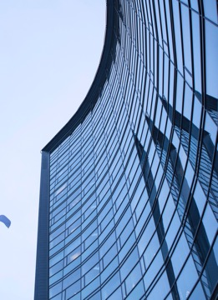
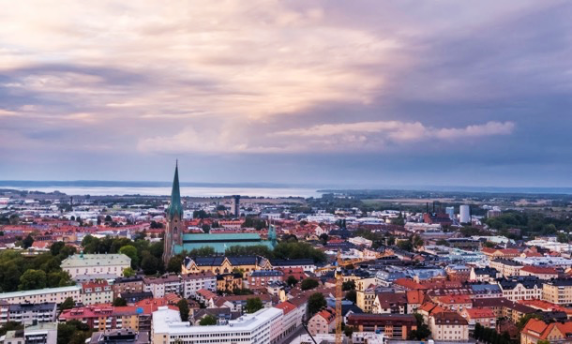

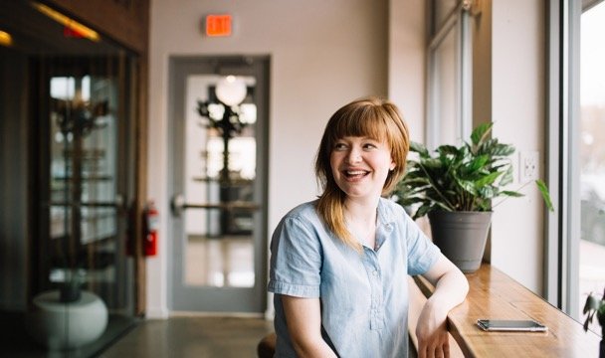
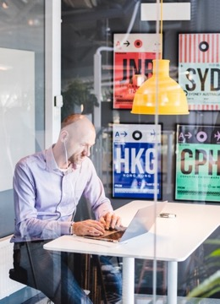
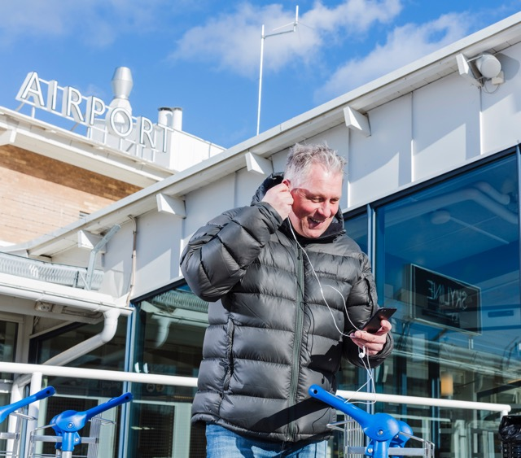
03
The perfect location

Slide 10
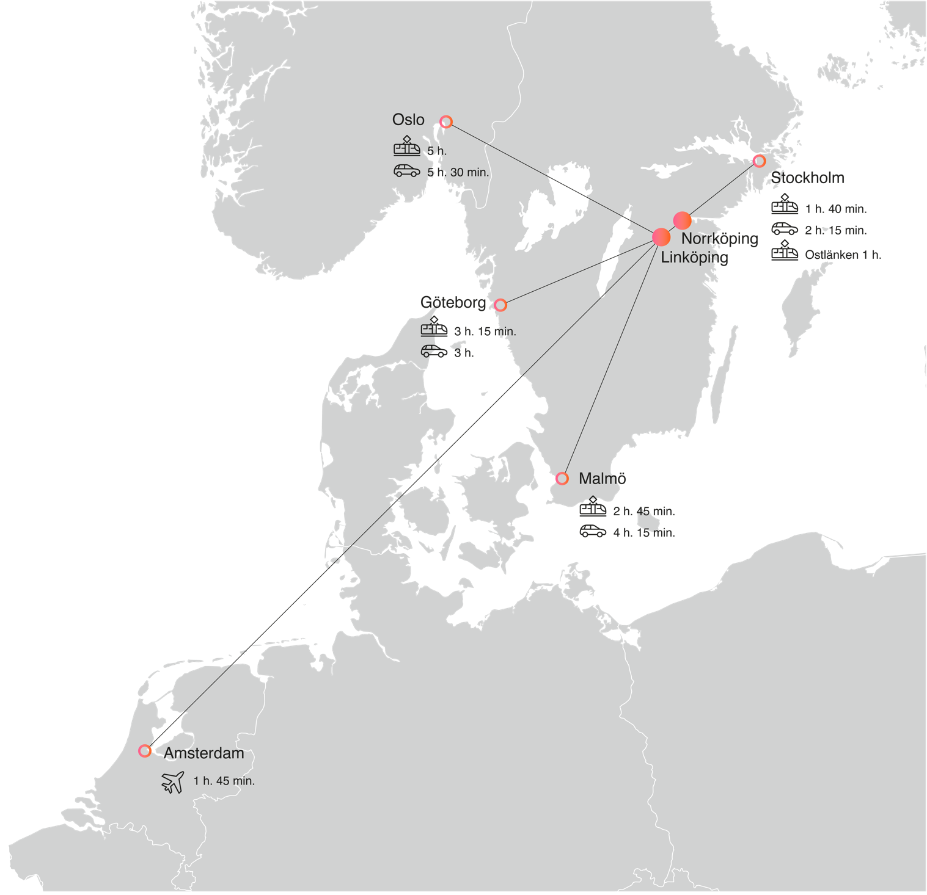
A perfect starting point to live and work on
A perfect logistical location together with Norrköping
Excellent transport – E4, high-speed trains, airports
50% of Sweden's population lives within a radius of 25,000 km
Notes:
A perfect logistical location together with Norrköping
With excellent transport: It is easy to get to Linköping and leave
Here you will find the motor way E4, Linköping City Airport, high-speed trains and the future even faster high-speed train Ostlänken
The high-speed train can take you to Stockholm in 1.40 hours and you can get to Amsterdam by air in the same time and then further out in the world.
With Ostlänken, travel time from Linköping to Stockholm will be 1 hour.
Half of Sweden's population and ¼ of the country's industrial production are found within a radius of 250 km.

Slide 11
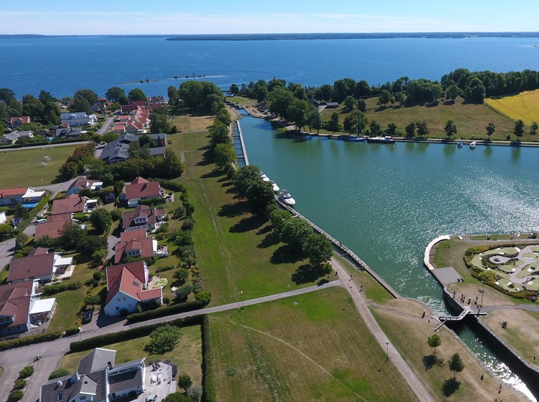
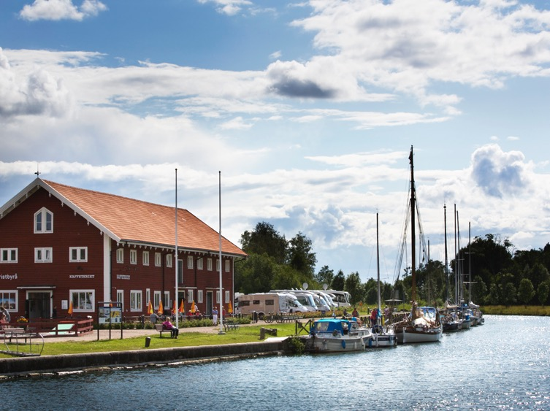
Foto: Carl Schnell
In the midst of wonderful surroundings
Close to Östergötland's archipelagos and beautiful lakes with many bathing areas and boating opportunities.
Well-known Göta Kanal with Bergs slussar (Berg’s locks) and Kinda Kanal flows through the city
Eklandskapet (Oak Landscape) just south of Linköping is the most important area in Europe for the biodiversity associated with the oak.
Foto: Niclas Albinsson
Notes:
Linköping is in a great location. It is close to Östergötland's archipelagos and beautiful lakes with many bathing areas and boating opportunities. You can get to St. Anna's archipelago in an hour by car, and you can get to Varamobaden at lake Vättern with a 5 km long sandy beach within an hour.
One of Sweden's most popular attractions, Göta Kanal, starts at Bergs slussar (Berg’s locks) ten minutes from the city centre. It is connected with Kinda Kanal that runs from lake Åsunden in southern Östergötland through Linköping to Roxen. Göta Kanal is one of Sweden's largest tourist destinations.
From Linköping and further south, you’ll find the unique Eklandskapet (Oak Landscape). It’s the most important area in Europe for the biodiversity associated with the oak. The oaks and other temperate deciduous trees thrive in Östergötland thanks to the many fertile valleys. All of Eklandskapet (Oak Landscape) is a unique beauty experience.
It’s easy to have a good time and play here

Slide 12

Strong collaborative climate – the Linköping spirit
Notes:
Strong contributor to our success in Linköping. The university, businesses and politics work together in the city's best interests.
The new innovative neighbourhoods Vallastaden and Ebbe Park are evidence of this.
Companies help companies and there are also many different advisors available at Lead, Nyföretagarcentrum, Almi and others.

Slide 13
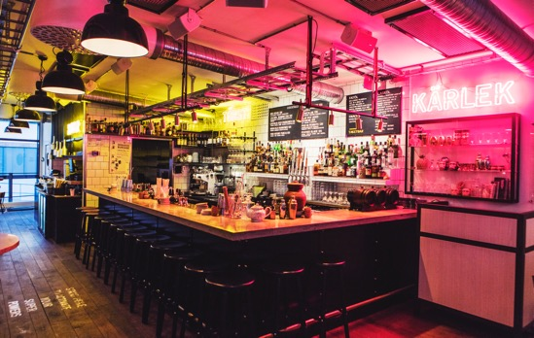


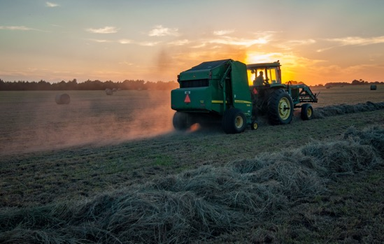
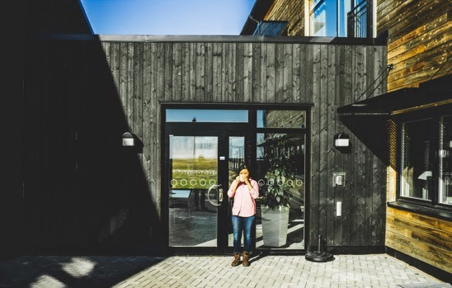
Position:
Future Now
Notes:
With the three areas of strength as a basis, our position is (i.e. how we differ from other places):
Linköping – Future Now
1. There is cutting-edge technology, successful companies and a world-class university here. From here comes the new groundbreaking innovations
2. An appealing place where you have the opportunity to shape and realise your future according to your ideas.

Slide 14

Brand promise:
Where ideas come to life
Notes:
The position shows how we are going to distinguish ourselves and be perceived. The position gives the brand promise a meaning and what we promise to deliver to our target audiences.
‘Linköping – where ideas come to life
Ideas from our areas of expertise will become new innovations, new companies.
Ideas of how you want to shape your life can become a reality in Linköping.

Slide 15
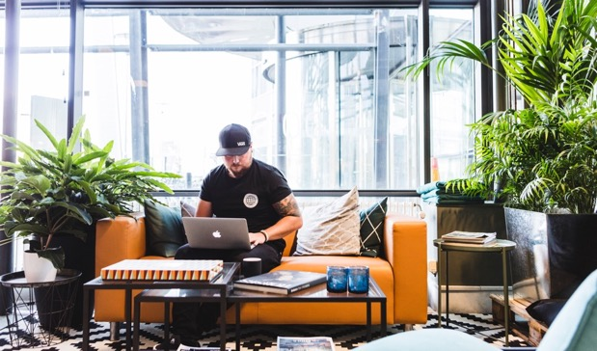
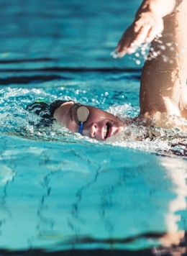
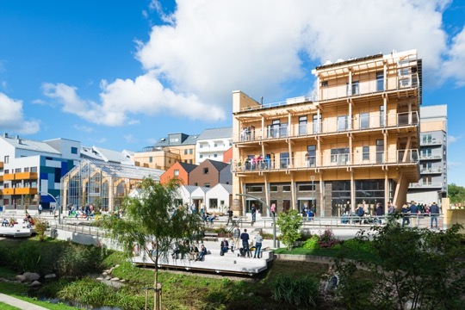
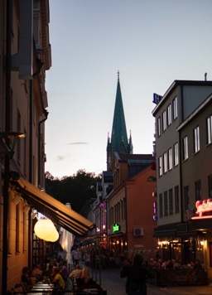
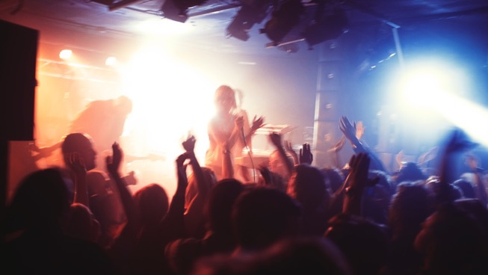
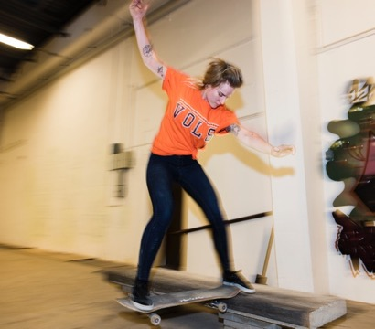
Thanks!

